Slide 1
Replace energy provider GW & AURI w/ DNHR & EUCT to decrease energy loss.
Joshua Young

Slide 2
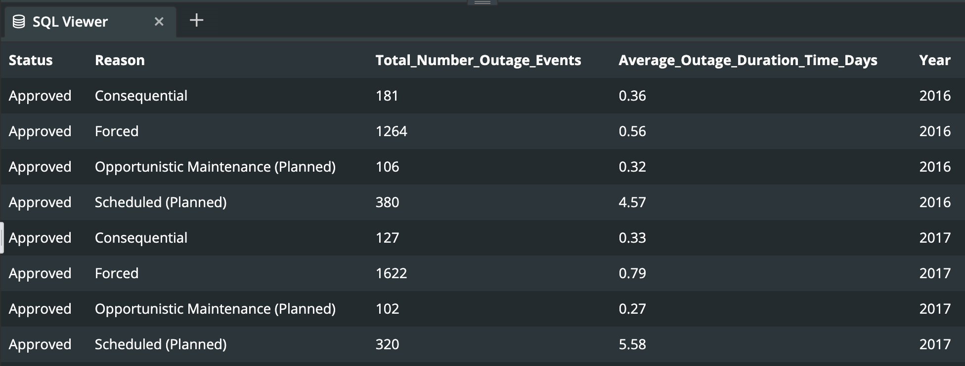
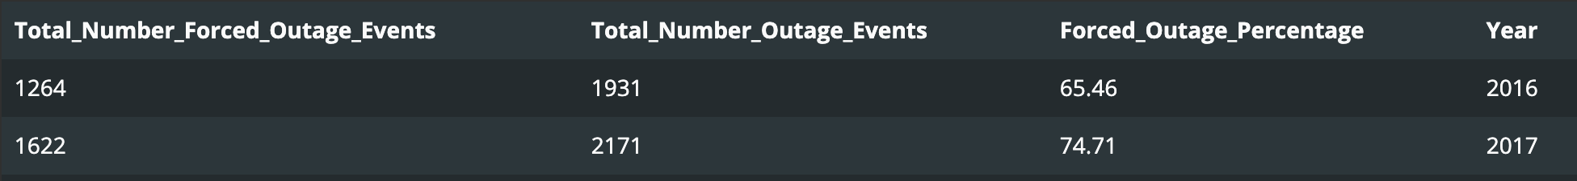
AEMR has more Forced Outages than any other event, by a factor of 4x minimum & it’s increasing

Slide 3
Most outages: 2017: October & December 2016: February

Slide 4
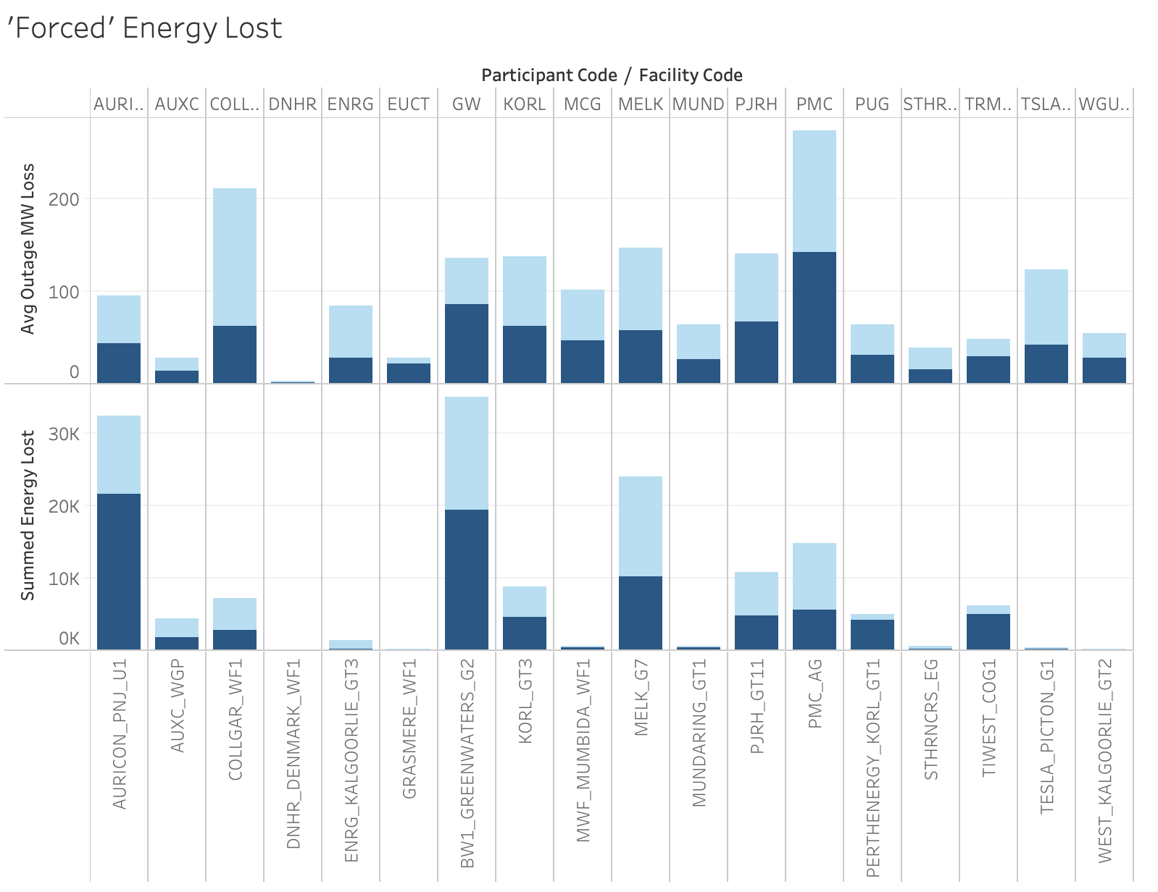
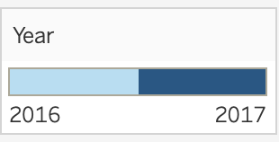
GW & AURI created the most energy lost. Be concerned about PMC.

